Slide 1

Hash Table
Presented by:
Elizer Ponio Jr.

Slide 2
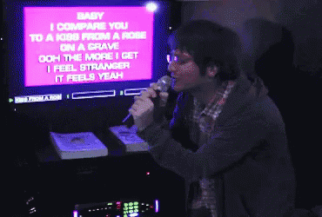
Finding a song in a videoke songbook
Notes:
Have you asked yourself the question, why do people organize?
Lets go to the psychology of organizing
This predictability applies within the context of our homes, manifesting through the concept of organization

Slide 3
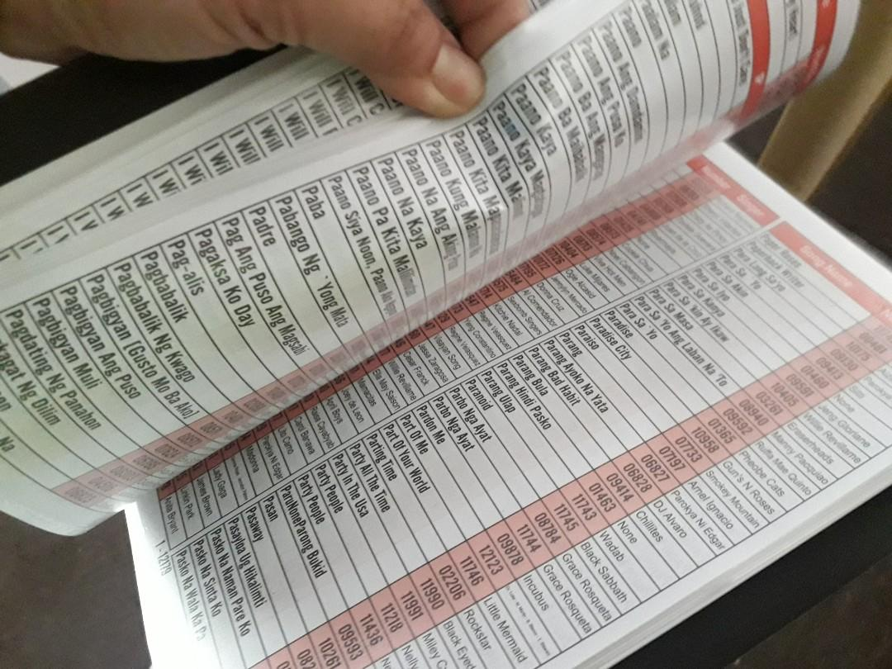
Finding a song in a videoke songbook
If the song book is unordered (the songs titles are not sorted from A-Z), we would be doing simple search.
Simple search would take linear time O(n).
If the song book is ordered, we can apply binary search.
Binary search would take logarithmic time O(log n)
Notes:
Have you asked yourself the question, why do people organize?
Lets go to the psychology of organizing
This predictability applies within the context of our homes, manifesting through the concept of organization

Slide 4
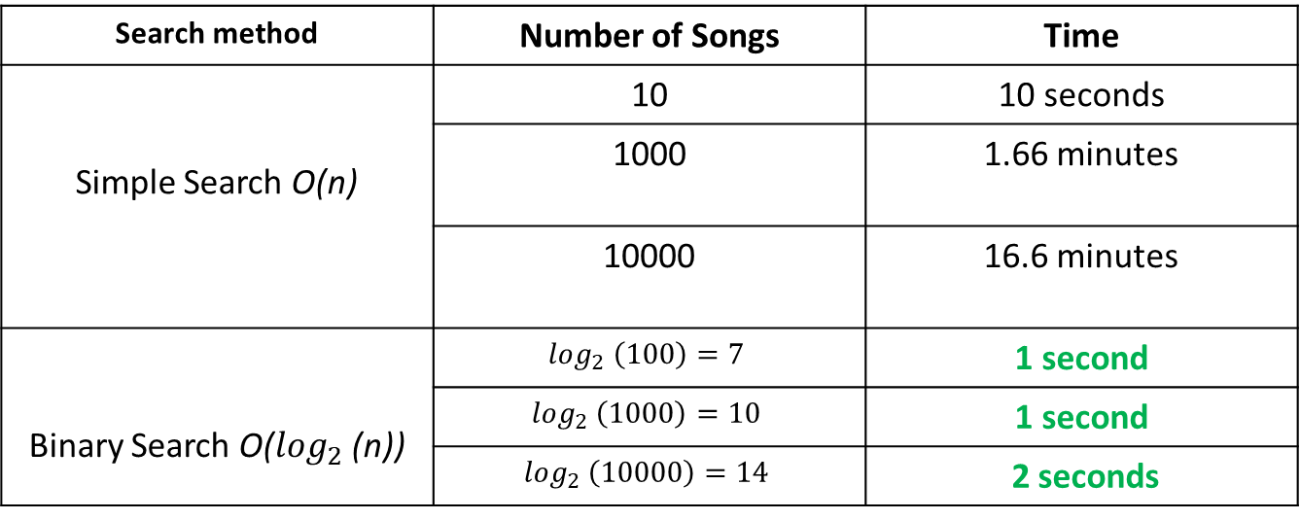
Linear time vs Logarithmic time
Suppose you could browse through 10 songs per second.
Search method | Number of Songs | Time
Simple Search O(n) | 10 | 10 seconds
Simple | 1000 | 1.66 minutes
Simple | 10000 | 16.6 minutes
Binary Search O($\log_{2}$ (n)) | $$\log_{2} \left(100\right)=7$$ | 1 second
 | $$\log_{2} \left(1000\right)=10$$ | 1 second
 | $$\log_{2} \left(10000\right)=14$$ | 2 seconds
Notes:
Have you asked yourself the question, why do people organize?
Lets go to the psychology of organizing
This predictability applies within the context of our homes, manifesting through the concept of organization

Slide 5
Can we do a faster search?
Yes!
Notes:
Have you asked yourself the question, why do people organize?
Lets go to the psychology of organizing
This predictability applies within the context of our homes, manifesting through the concept of organization

Slide 6

Faster than binary search
You noticed your friend always has the microphone singing all night.
Your friend has already sung 10 songs while you and your other friends are still searching for a song.
You noticed that your friend does not even use the song book to search for a song. Your friend knows the song code instantly!
What is the search method your friend is using?
Notes:
Have you asked yourself the question, why do people organize?
Lets go to the psychology of organizing
This predictability applies within the context of our homes, manifesting through the concept of organization

Slide 7
Search in constant time 0(1)
Your friend told you that he memorized all the song titles and song codes in the song book.
Your friend is even faster than binary search.
Your friend can search for a song in constant time O(1).
Notes:
Have you asked yourself the question, why do people organize?
Lets go to the psychology of organizing
This predictability applies within the context of our homes, manifesting through the concept of organization

Slide 8
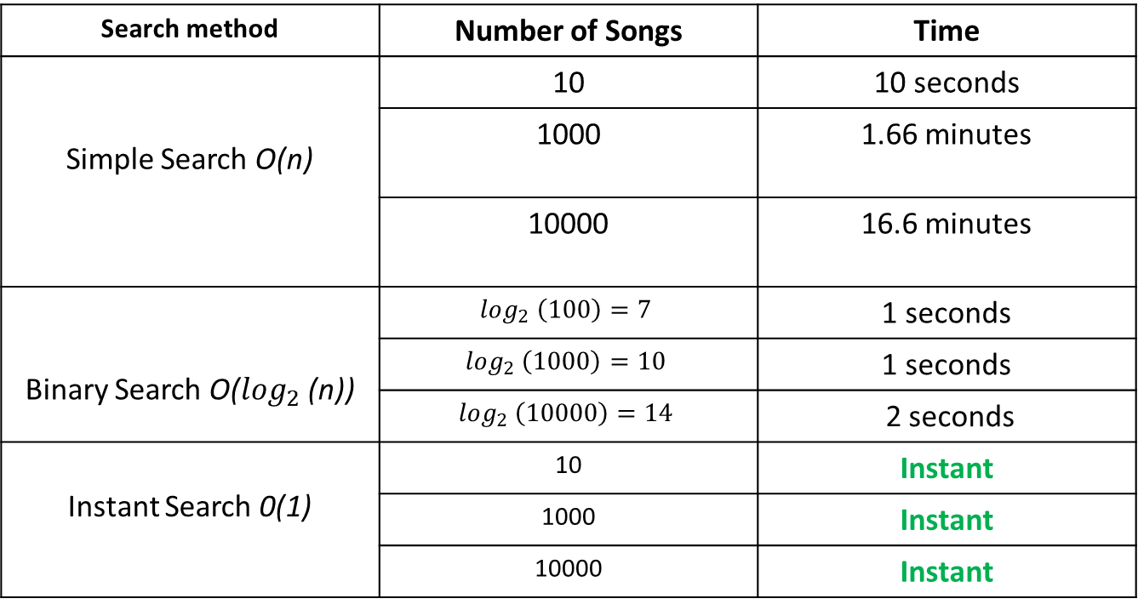
Search in constant time 0(1)
Search method | Number of Songs | Time
Simple Search O(n) | 10 | 10 seconds
Simple | 1000 | 1.66 minutes
Simple | 10000 | 16.6 minutes
Binary Search O($\log_{2}$ (n)) | $$\log_{2} \left(100\right)=7$$ | 1 seconds
 | $$\log_{2} \left(1000\right)=10$$ | 1 seconds
 | $$\log_{2} \left(10000\right)=14$$ | 2 seconds
Instant Search 0(1) | 10 | Instant
 | 1000 | Instant
 | 10000 | Instant
Notes:
Have you asked yourself the question, why do people organize?
Lets go to the psychology of organizing
This predictability applies within the context of our homes, manifesting through the concept of organization

Slide 9
How to do instant search?
Hashing!
Notes:
Have you asked yourself the question, why do people organize?
Lets go to the psychology of organizing
This predictability applies within the context of our homes, manifesting through the concept of organization

Slide 10
Hashing
Hashing is a technique of mapping a large set of arbitrary data to tabular indexes using a hash function.
Notes:
Have you asked yourself the question, why do people organize?
Lets go to the psychology of organizing
This predictability applies within the context of our homes, manifesting through the concept of organization

Slide 11
Hash Function
A function that is used to both map and retrieve data in a hash table.
Notes:
Have you asked yourself the question, why do people organize?
Lets go to the psychology of organizing
This predictability applies within the context of our homes, manifesting through the concept of organization

Slide 12

Hashing
Notes:
Have you asked yourself the question, why do people organize?
Lets go to the psychology of organizing
This predictability applies within the context of our homes, manifesting through the concept of organization

Slide 13

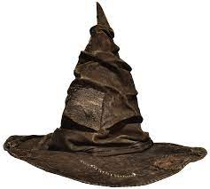





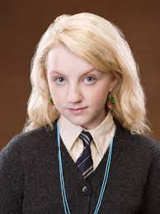

Sorting Hat Hash Function
Notes:
Have you asked yourself the question, why do people organize?
Lets go to the psychology of organizing
This predictability applies within the context of our homes, manifesting through the concept of organization

Slide 14
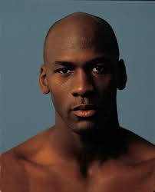


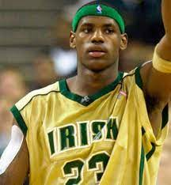

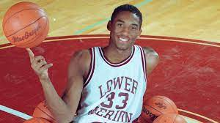

NBA Draft Hash Function
Notes:
Have you asked yourself the question, why do people organize?
Lets go to the psychology of organizing
This predictability applies within the context of our homes, manifesting through the concept of organization

Slide 15
Hash table
Stores elements in key-value pairs where,
Key
Unique string/integer that is used for indexing/retrieving values.
Value
Data that are associated with keys.
Notes:
Have you asked yourself the question, why do people organize?
Lets go to the psychology of organizing
This predictability applies within the context of our homes, manifesting through the concept of organization

Slide 16
Key – Value Pairs
Song Title (Key) | Song Code (Value)
High hopes | 0000
This Love | 1111
God’s Plan | 2222
Sugar | 3333
Notes:
Have you asked yourself the question, why do people organize?
Lets go to the psychology of organizing
This predictability applies within the context of our homes, manifesting through the concept of organization

Slide 17

Hash table
High Hopes
0
Hash function
0 | 1 | 2 | 3
0000
Notes:
Have you asked yourself the question, why do people organize?
Lets go to the psychology of organizing
This predictability applies within the context of our homes, manifesting through the concept of organization

Slide 18
Hash table
This Love
1
Hash function
0 | 1 | 2 | 3
0000
1111
Notes:
Have you asked yourself the question, why do people organize?
Lets go to the psychology of organizing
This predictability applies within the context of our homes, manifesting through the concept of organization

Slide 19
Hash table
God’s Plan
2
Hash function
0 | 1 | 2 | 3
0000
1111
2222
Notes:
Have you asked yourself the question, why do people organize?
Lets go to the psychology of organizing
This predictability applies within the context of our homes, manifesting through the concept of organization

Slide 20
Hash table
Sugar
2
Hash function
0 | 1 | 2 | 3
0000
1111
2222
3333
Notes:
Have you asked yourself the question, why do people organize?
Lets go to the psychology of organizing
This predictability applies within the context of our homes, manifesting through the concept of organization

Slide 21
Hash table Operations
Put
Remove
Get
Clear
Size
Notes:
Have you asked yourself the question, why do people organize?
Lets go to the psychology of organizing
This predictability applies within the context of our homes, manifesting through the concept of organization

Slide 22
Put
Inserts a key and a value into the hash table.
Notes:
Have you asked yourself the question, why do people organize?
Lets go to the psychology of organizing
This predictability applies within the context of our homes, manifesting through the concept of organization

Slide 23
Remove
Removes the key and its value.
Notes:
Have you asked yourself the question, why do people organize?
Lets go to the psychology of organizing
This predictability applies within the context of our homes, manifesting through the concept of organization

Slide 24
Get
Returns the object that contains the value associated with the key.
Notes:
Have you asked yourself the question, why do people organize?
Lets go to the psychology of organizing
This predictability applies within the context of our homes, manifesting through the concept of organization

Slide 25
Clear
Resets and empties the hash table.
Notes:
Have you asked yourself the question, why do people organize?
Lets go to the psychology of organizing
This predictability applies within the context of our homes, manifesting through the concept of organization

Slide 26
Size
Returns the number of entries in the hash table.
Notes:
Have you asked yourself the question, why do people organize?
Lets go to the psychology of organizing
This predictability applies within the context of our homes, manifesting through the concept of organization

